Slide 2
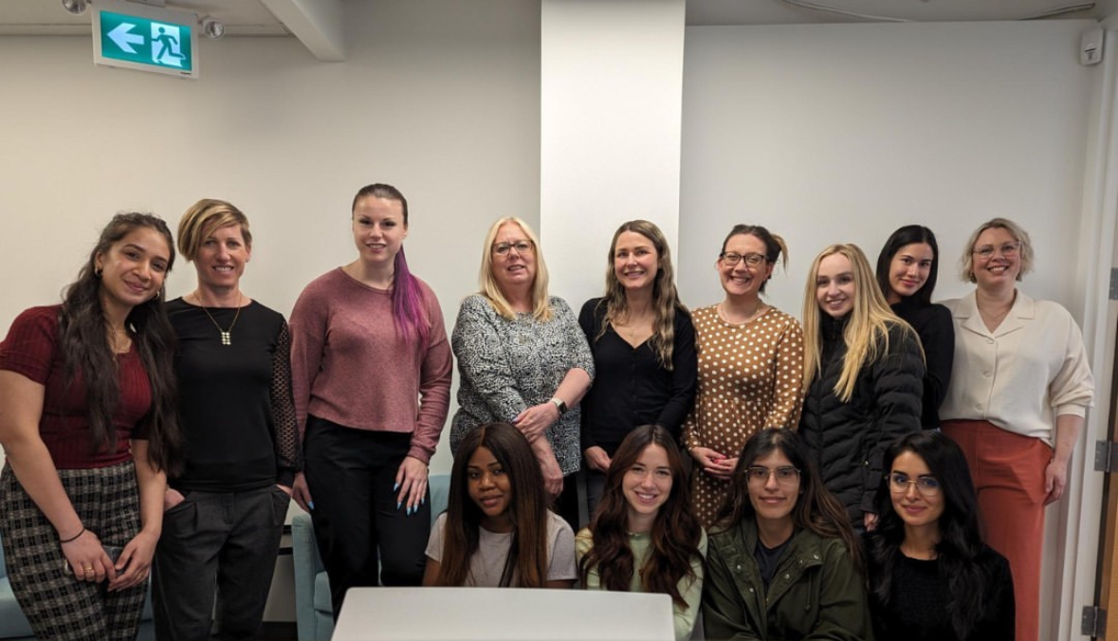
Who are we?
At the Belonging Network (formerly Adoptive Families Association of BC), we provide support, learning, and connection for adoptive and permanency families and youth from government care.
We focus on the following:
Free virtual support
Support for youth
Adoption and permanency training
Online workshops and courses
Notes:
I am going to begin today by chatting about the free virtual support we offer.
Then we will talk a bit about support we offer to youth
As well as adoption and permanency training and workshops

Slide 3

Message from Christina Kunz

Slide 4
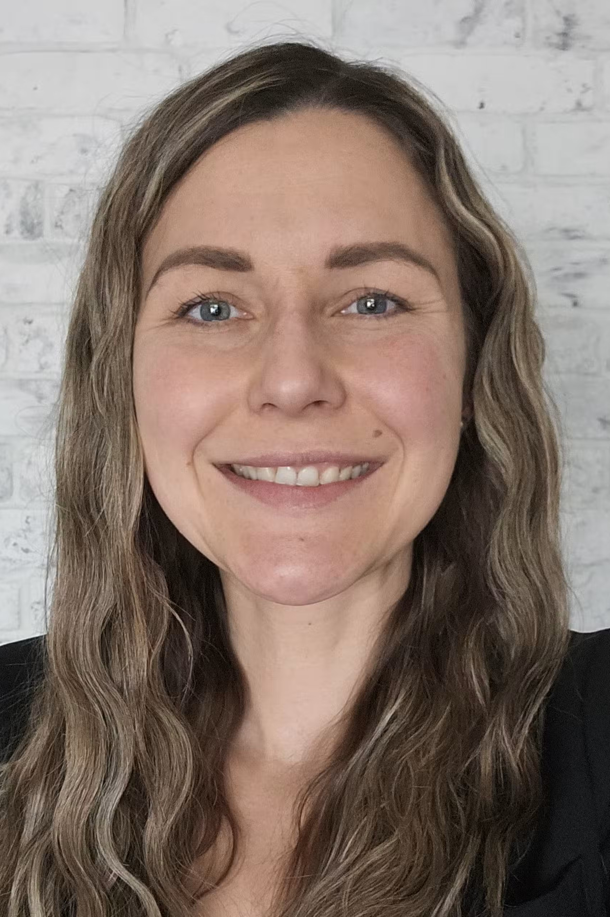
Free virtual support
Free 1:1 support for families
  Call 778-897-1315
  Email familysupport@belongingnetwork.com
  We’re open Monday to Friday, 9:00AM – 4:30PM
Coffee Chat online support group
  This group is held on most Wednesday mornings from 10 to 11AM
Waiting Parents support discussion group
  This group is held monthly from 5-6 PM
Face to face connections
  Join monthly for the online parents’ meet up, hosted by volunteer adoptive parents
Notes:
Our drop-in Coffee Chat group provides a casual, safe, and welcoming virtual space for adoptive and permanency parents or guardians to connect. Share your stories, listen to each other, and build a network of support with people who understand what you’re going through.

Slide 5

Free virtual Facebook supports
Connecting and Supporting Families
Parenting Indigenous Children
Complex Needs Parent
2SLGBTQIA+ Parent
Parenting Teens
Notes:
All of our groups are private. Christina and here team will approve who can join.
Connecting and Supporting Families: offer adoptive and permanency parents to discuss current adoption issues and share experiences.
Parenting Indigenous Children supports parents and caregivers of Indigenous children and allows them to share insights and support one another.
Complex Needs focuses on needs, such as FASD, to offer an environment where people can provide mutual support and share experiences.
2SLGBTQIA+ is another group that we offer to supports families who are part of the 2SLGBTQIA+ community.
Parenting Teens: if you’re parenting a teens this is a great channel to join to share, learn, and navigate common challenges together.

Slide 6
Other support available
Referrals
We can connect you with professionals who understand the unique experiences of kinship, adoptive, and permanency families.
In-person family events
All permanency families are welcome at our in-person events held in the Lower Mainland and Victoria through our Face to Face Connections Program
Information & resources
We’ll guide you to helpful information tailored to your family’s needs, keep you informed about upcoming workshops, webinars, grants and point you to the right support when you need them.

Slide 7
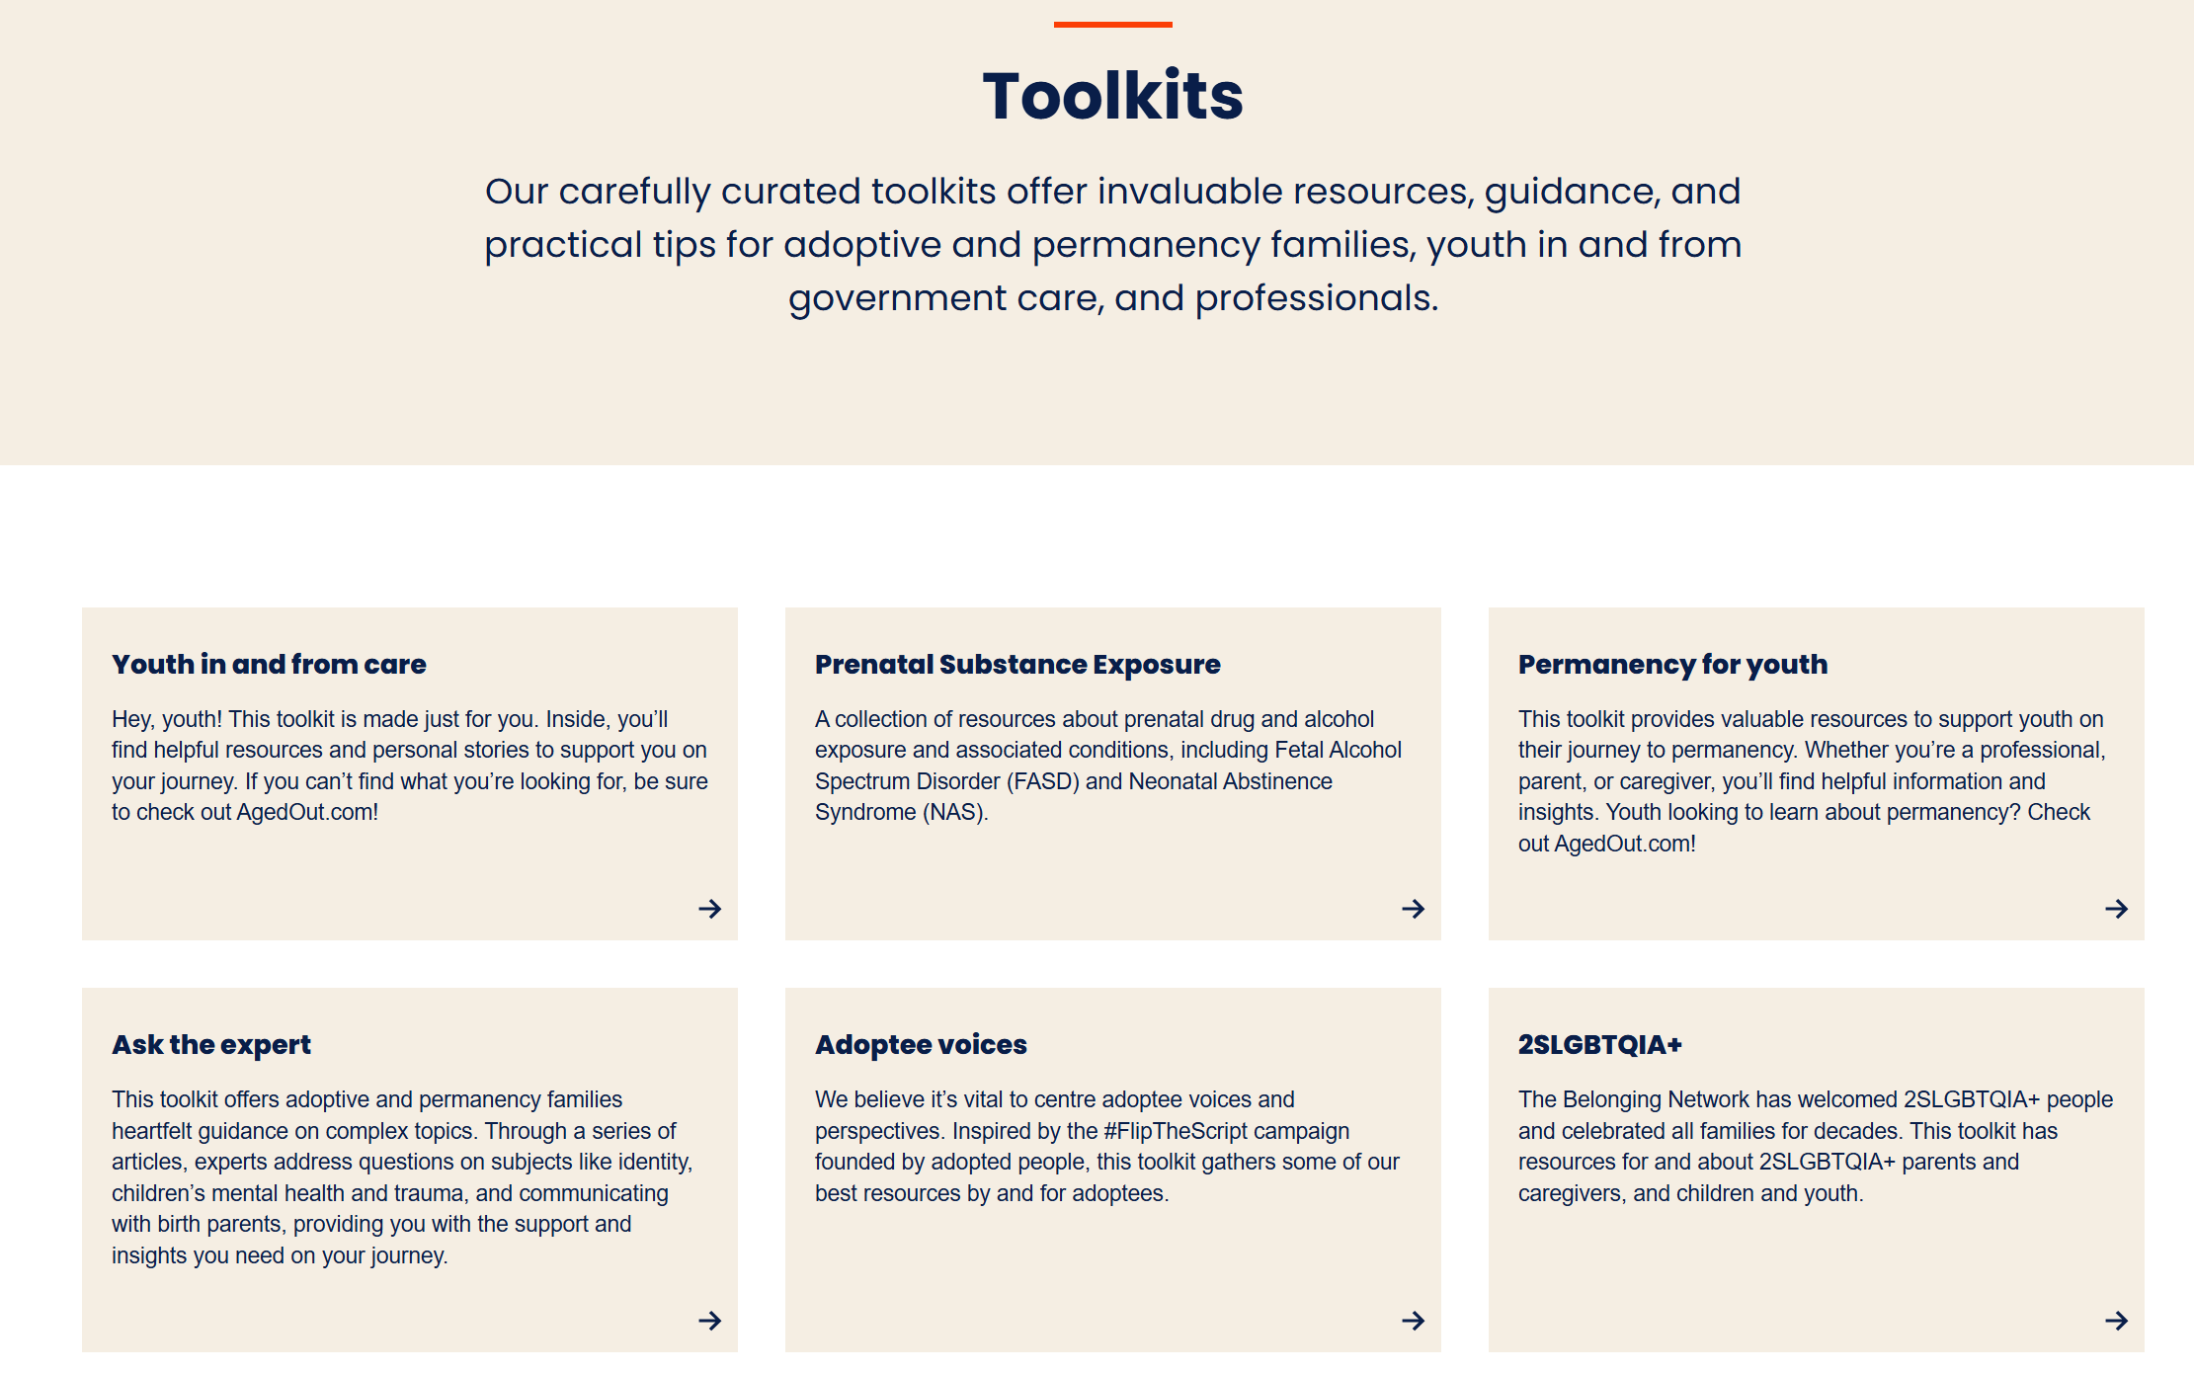
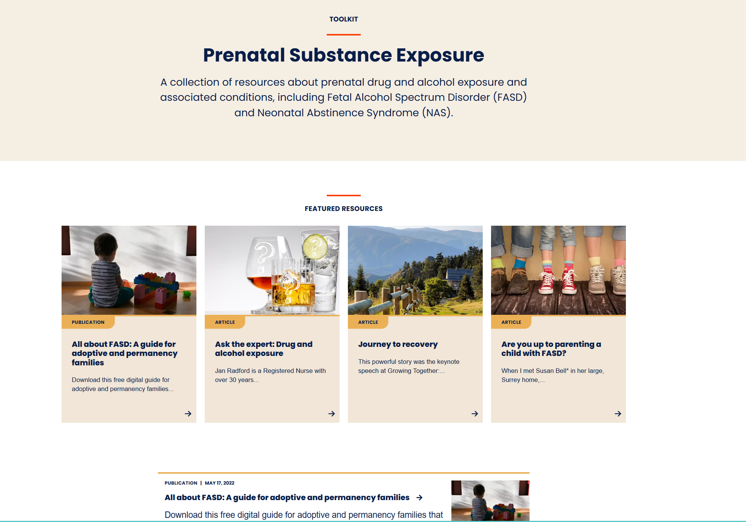
Free virtual supports - Toolkits

Slide 8
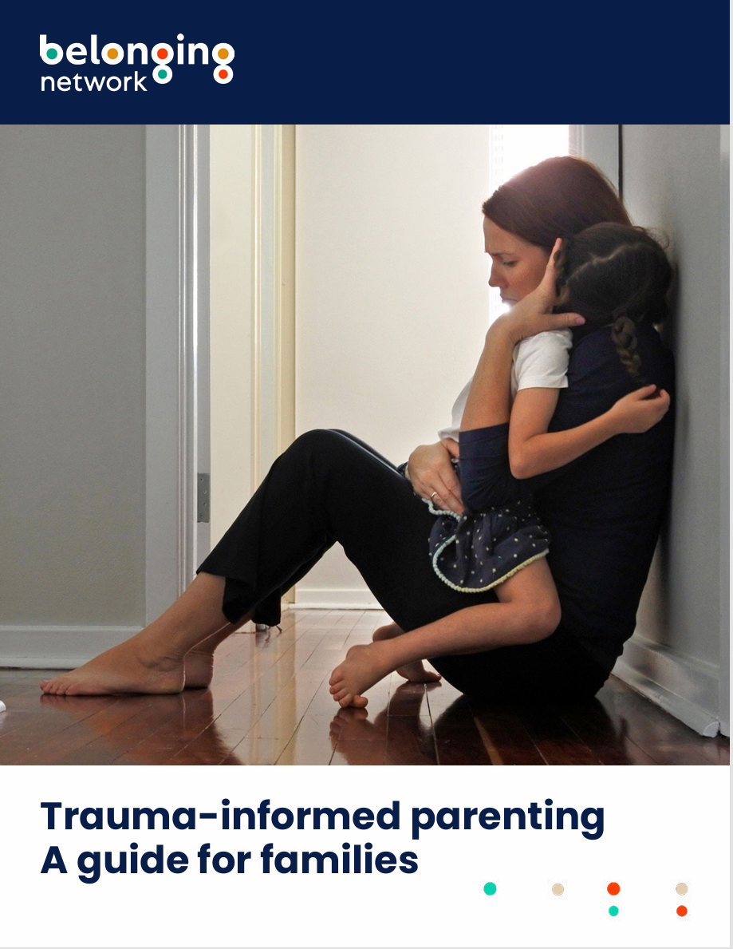
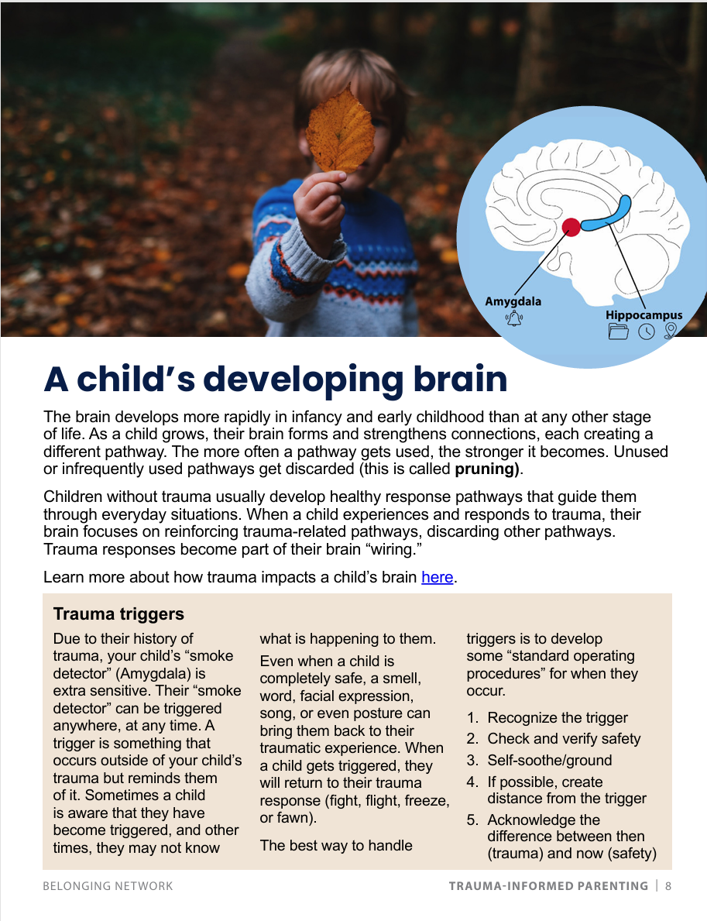
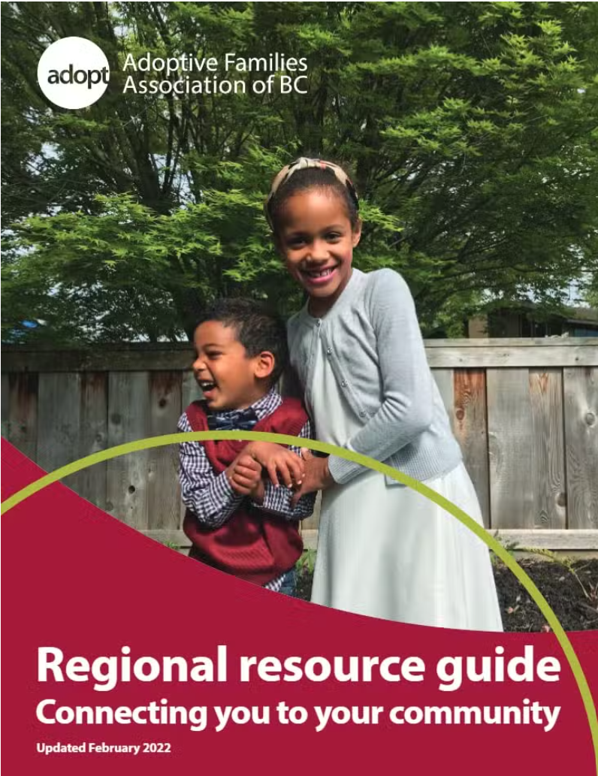
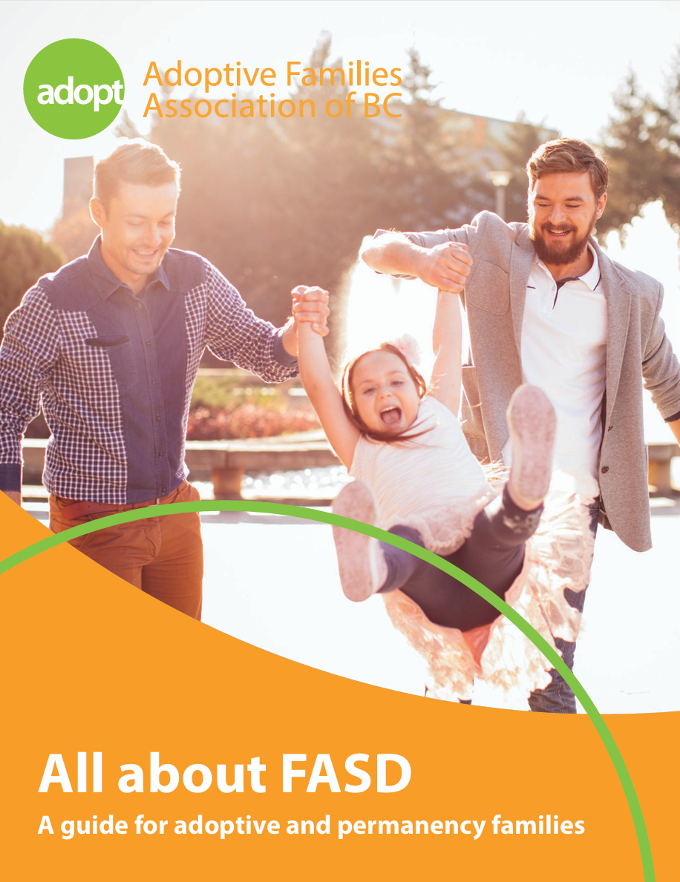
Free virtual supports – Guides
Source: https://belongingnetwork.com/resources-education/resources/
Notes:
Here are a couple of examples of guides we offer
These guides include:
Stories from families
Information from professional
Resource

Slide 9
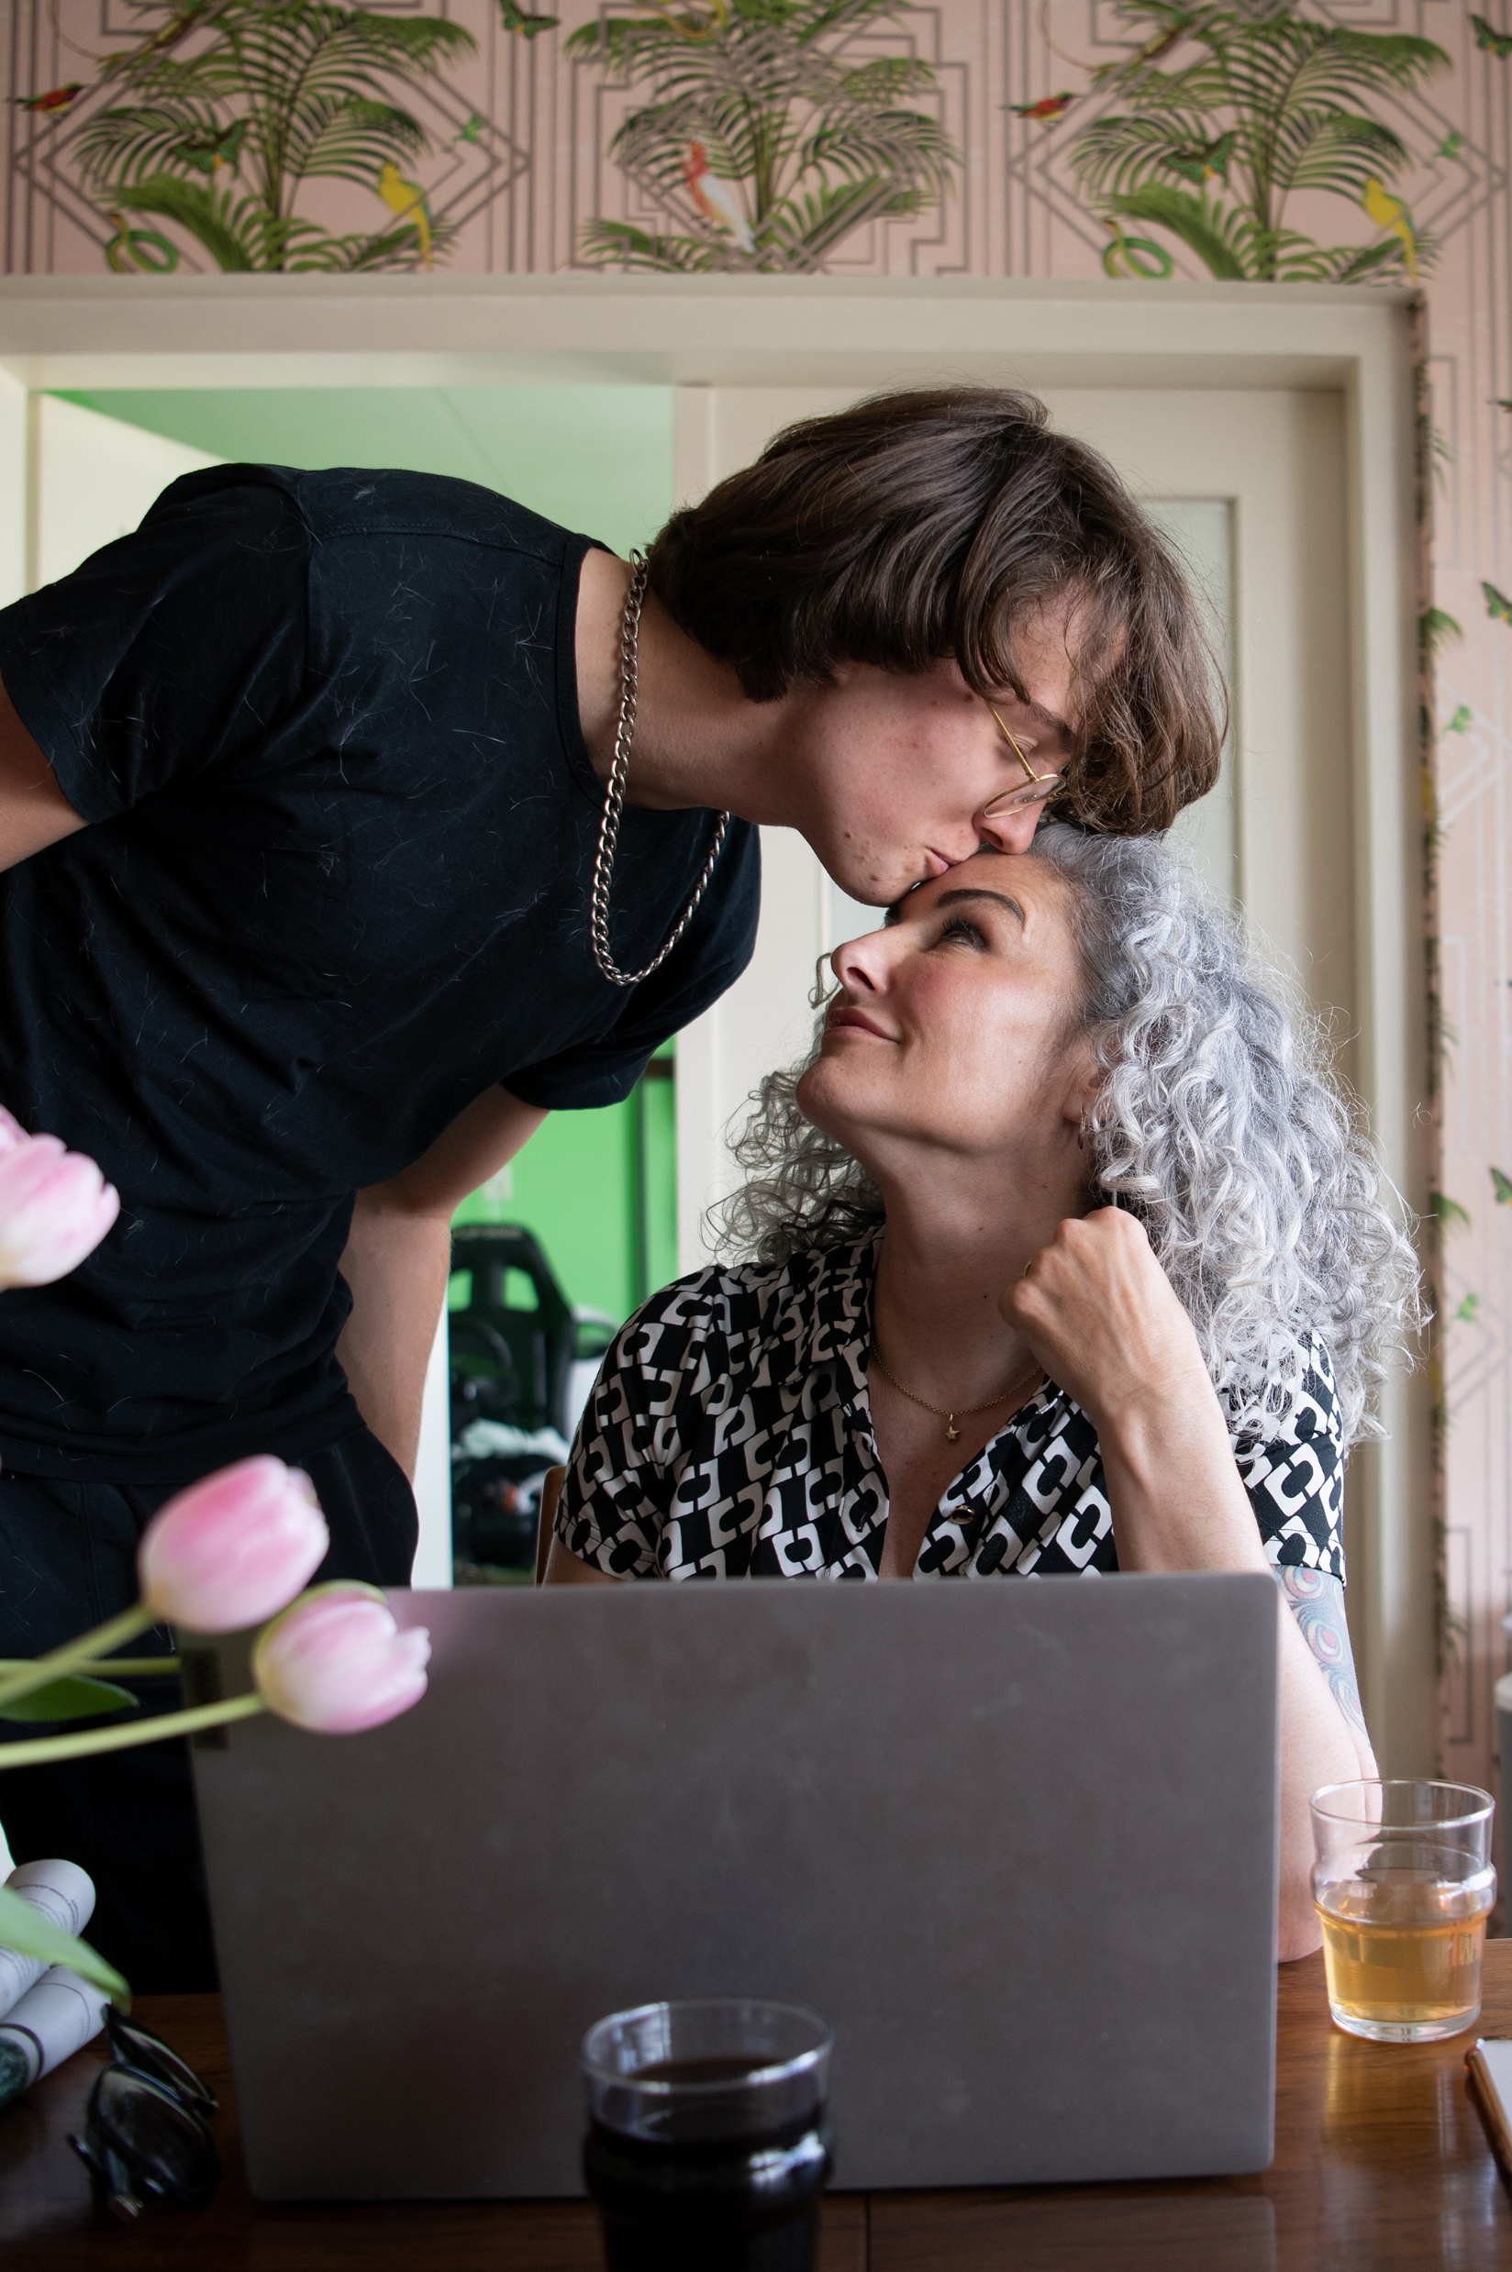

Support for youth
Agedout.com
SAJE
Three bursaries

Slide 10
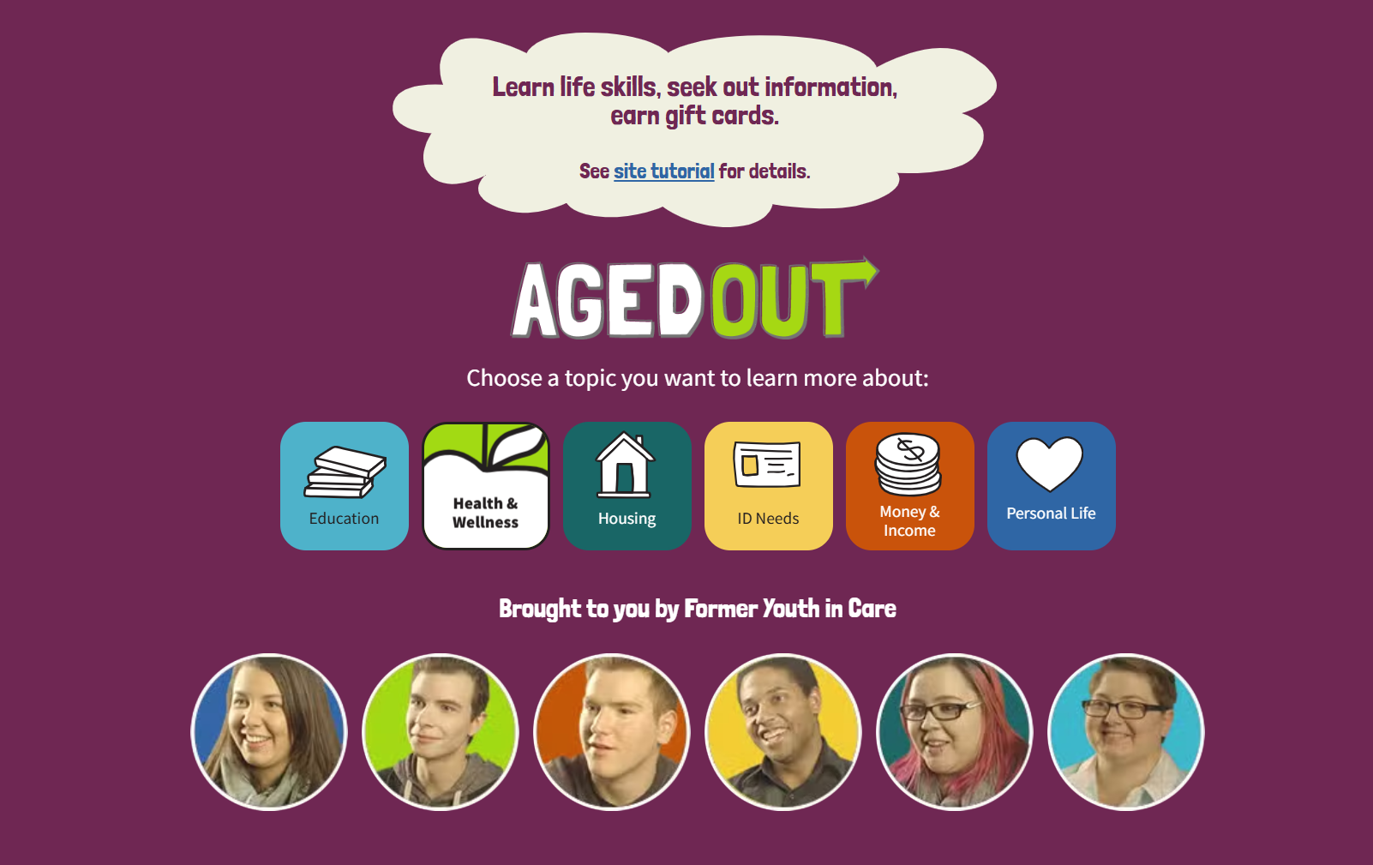

Slide 11
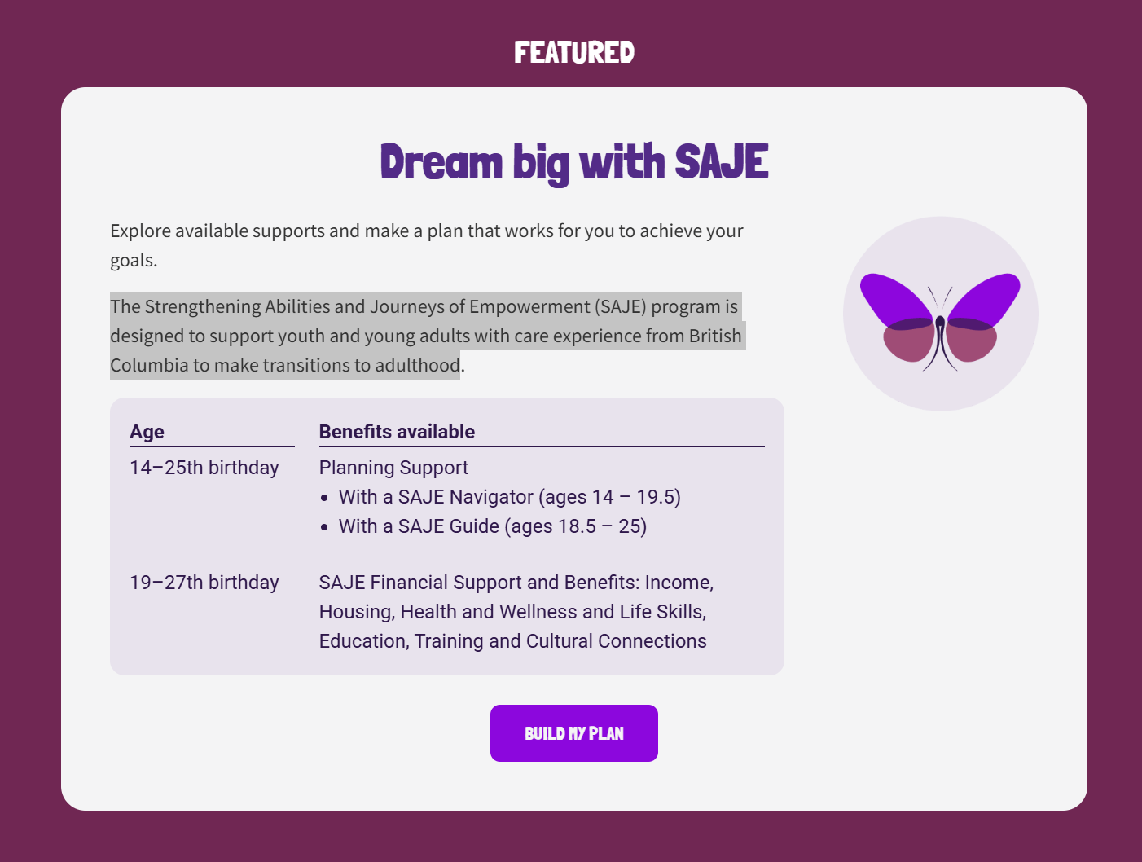
Eligibility
Young adults between the ages of 19 to 26 (up to their 27th birthday) are eligible for SAJE if:
They reached their 19th birthday while on a Youth Agreement, a Continuing Custody Order or were under the personal guardianship of a director, OR
They achieved permanency between the ages of 12-19 (i.e., adoption after being in care, or under section 54.1 or 54.01), OR
They have 24 months of cumulative time in care between the ages of 12-19, in a range of in- and out-of-care statuses, OR
They were in a comparable arrangement under Indigenous law.

Slide 12

Notes:
If you had a Continuing Custody Order (CCO) and are:
Under 19 years old
19-24 years old
Over 24 years old
If you had a Temporary Custody Order (TCO) and are:
Under 19 to 25 years old
Over 24 years old
If you had a Youth Agreement (YAG) and are:
Under 19 years old
19-24 years old
Over 24 years old
If you had a transfer of custody (54.1):

Slide 13
Support for youth
Bursary | Eligibility
BC Orca | This bursary is for youth from care. For this program, “youth from care” is defined as: having been in care of government for at least two years (includes voluntary care agreements, special needs agreements, youth agreements, independent living agreements, temporary custody orders, or continuing custody orders); or lived with a family member (other than a parent) or another adult for at least two years, as part of an agreement or custody order with the Ministry of Children and Family Development or a Delegated Aboriginal Agency; or been on a youth agreement for at least two years. Other extenuating circumstances will be considered. Other requirements You are currently a BC resident. You are a youth in or from government care in BC (according to the definition above specified by the Ministry of Child and Family Development, with special consideration for extenuating circumstances) You are 26 years of age or younger at the application deadline. You are registered, or plan to be registered, in a post-secondary program at an accredited BC institution resulting in a degree or diploma. Your start date must be within one year of the application deadline. Recipients will be required to provide proof of enrollment.
Bursary applications

Slide 14
Support for youth
Bursary | Eligibility
Joy McPhail | You are currently a BC resident. You are a youth who has joined their family by legal adoption or another form of permanency. You are between the ages of 17 and 26 by the date of the application deadline. You are registered, or plan to be registered, in a post-secondary program at an accredited BC institution resulting in a degree or diploma. Recipients will be required to provide proof of enrollment.
Vancouver Film Studio | You are currently a BC resident. You identify as an Indigenous person.
Bursary applications

Slide 15

Adoption and permanency training
The Belonging Network offers an adoption and permanency education course to those required to take pre-adoption education. The course is also available to those on a permanency journey interested in learning more.

Slide 16
Adoption and permanency training
Introduction to adoption and permanency
Topics: Financial and legal issues, children eligible for adoption, the adoption process, and challenges during the process.
Cost: Free
Learning for Everyone in Adoption and Permanency
Cost: Varies

Slide 17

LEAP
Topics include:
Trauma, attachment, openness with birth parents/family, prenatal exposure to drugs and alcohol, cultural understanding, and Indigenous content.
Outline
10 weeks
4 mandatory live discussions
Journals, videos, and articles
Expanding our material to support:
Kinship families
Indigenous families
Permanency families

Slide 18
LEAP requirements
Approved by an MCFD social worker.
Cost: $95
Without MCFD involvement or approval.
Cost: $645

Slide 19

Trauma-informed parenting series
Trauma-informed parenting workshop - $95
Trauma-informed parenting support group - $10. The next session is on June 18th.
The facilitator is Ashleigh Martinflatt.
Over 20 years in the permanency field.
Master's in Social Work and is a Ph.D. candidate in Child and Youth Care.
Also, an adoptive and permanency mom to three

Slide 20
Workshops and courses
Safe Babies course - $150
Adoption and permanency awareness month is November. Host free workshops and events. Last year, we offered free workshops on topics such as:
  Digital literacy
  Supporting children who are 2SLGBTQia+
  Trauma-informed support

Slide 21
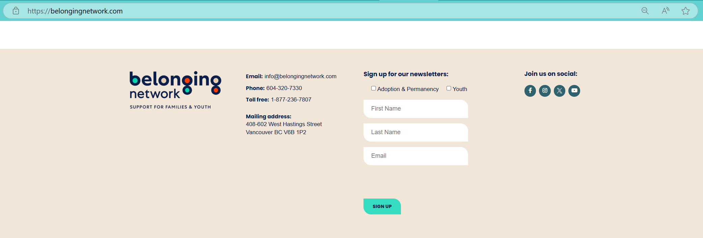
Join our newsletter!
Join our email newsletter to be the first to learn about new workshops and events.
Go to the Belonging Network website.
Scroll to the bottom of any page and fill out our newsletter.

Slide 22
Quick quiz!
Three questions. I will ask each question individually
First person to raise their hand and answer the questions correctly will get a water bottle

Slide 23
Question one:
How many bursaries does the Belonging Network offer?
Notes:
3

Slide 24
Question two:
What day does the Coffee Chat take place?
Notes:
Wednesday

Slide 25
Question three:
Which month is Adoption and Permanency Month?
Notes:
November

Slide 26
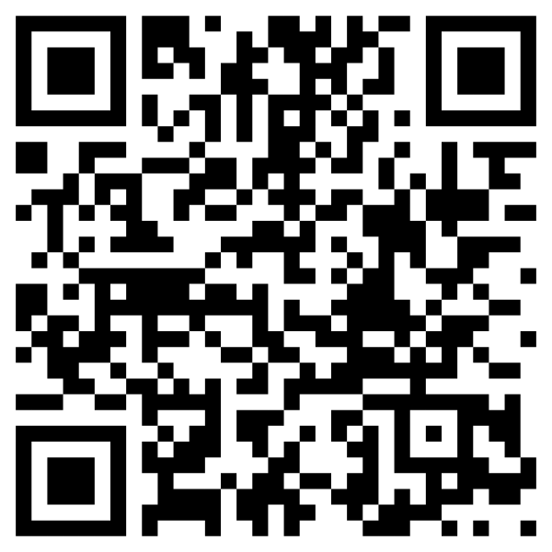
Tell us what you need!
https://www.surveymonkey.ca/r/WX9JYYY?cid1=[cid1_value]&cs=[cs_value
Notes:
https://www.surveymonkey.ca/r/WX9JYYY?cid1=[cid1_value]&cs=[cs_value

Slide 28

Free virtual supports –
Videos and articles

